Slide 1
Alternative protein and nutritional
supplements
Name – jeet Dodia
Batch – 14
Enrolment Number – BDA18
Problem id – pid001

Slide 2
Obejective Of This Project
Depending on the product, these include that alternative proteins are able to simulate the taste and texture of conventional meat, are more sustainable, i.e. have a smaller ecological footprint, are as, or more nutritious than conventional meat, protect animal welfare or contribute to food security.
further study is underway that analyses how the largest global food and meat companies are entering into the US alternative protein sector, and how they market the health and nutrition benefits of their products.

Slide 3
Use of the project
Depending on the product, these include that alternative proteins are able to simulate the taste and texture of conventional meat, are more sustainable, i.e. have a smaller ecological footprint, are as, or more nutritious than conventional meat, protect animal welfare or contribute to food security.
Alternative proteins are plant-based and food-technology alternatives to animal protein. They include food products made from plants (for example, grains, legumes and nuts), fungus (mushrooms), algae, insects and even cultured (lab-grown) meat. The Future Food Hallmark Research Initiative is an interdisciplinary research team that brings together food scientists and social scientists to explore the development of these novel products.

Slide 4
IN THIS PROJECT
HERE IN THIS PRESENTATION AT FIRST I AM GOING TO TELL YOU A MORE LITTLE BIT OF ALTERNATIVE PROTEIN.
AFTER THAT IN THIS PRESENTATION I AM GOING TO TELL YOU ABOUT THE FACTORS OF NUTRITIONAL SUPPLEMENTS.
AND THEN IN THIS PRESENTATION I AM GOING TO SHOW YOU THE KEY FEATURES OF PROTION AND SUPPLEMENTS.

Slide 5
Webiste link:-
https://www.alternativesprotein.com/

Slide 6
CONCEPTS USED IN THIS PROJECT
I MADE THIS PROJECT BY USING THE CONCEPTS OF C LANGUAGE INCLUDING POINTERS, ARRAY, AND LOOP.

Slide 7
COMPILER USED
I USED DEV++ COMPILER TO RUN THE CODE

Slide 8
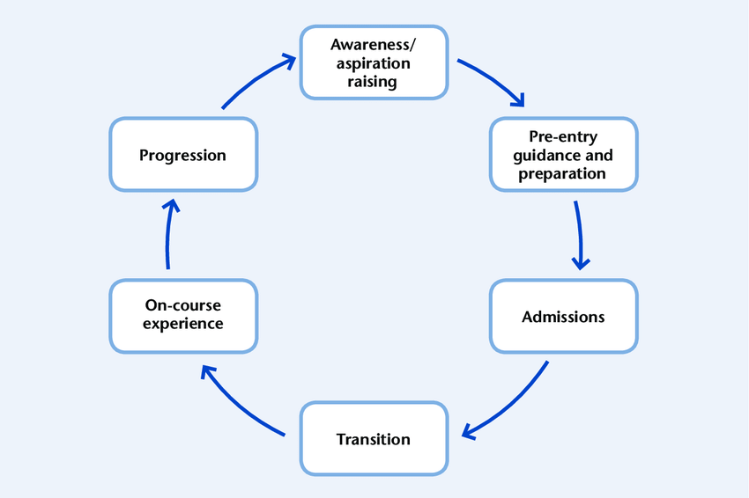
FLOWCHART OF ALTERNATIVE PROTEIN

Slide 9
FACTORS OF STUDENT LIFE CYCLE MANAGEMENT SYSTEM :
UIRY FOR ADMISSION
LACK OF NUTRITION
HIGH PRICE
PROGRAM AND COURSE STRUCTURE
TIMETABLE
ATTENDENCE RECORD
WORKOUT
MOTIVATION

